Slide 1
Summary:
Several pathways were reconstructed and/or exported from Pathway Studio for the project.
The presentation is about method and steps of pathway reconstruction.
The file “Pathways list and links.xlsx” contains links to free pathway viewer for browsing pathways, reading entity annotations and first 3 references for each link/relation
Folder with tables with proteins annotations (by pathway) (and tables with relations annotations and selected references). Only selected annotations and references were exported in tables (to make file sizes manageable). It is possible to export more by request. Resnet-2020 was used. It is possible to update files with Resnet-2021.
Folder “RNEF_SBGN” contains converted into SBGN files with pathways (no annotations, only layout (using convertor from https://github.com/golovatenkop/rnef2sbgn, http://web.newteditor.org/)

Slide 2
RASs → RAFs → MAPK2/3 (MEK) → MAPK1/3 (ERK)
signaling cascade
In Pathway Studio and text-mining network Resnet
Anastasia Nesterova,
nesterova.anastasia@gmail.com
pathwaystudio.com
https://mammalcedfx.pathwaystudio.com/app/search

Slide 3
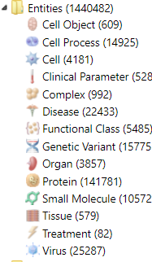
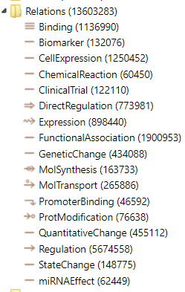
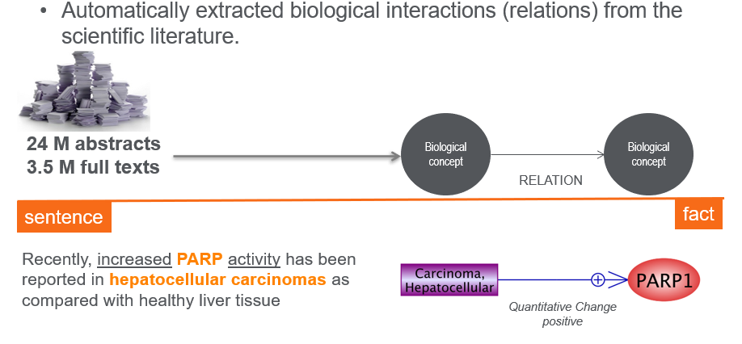
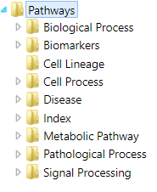
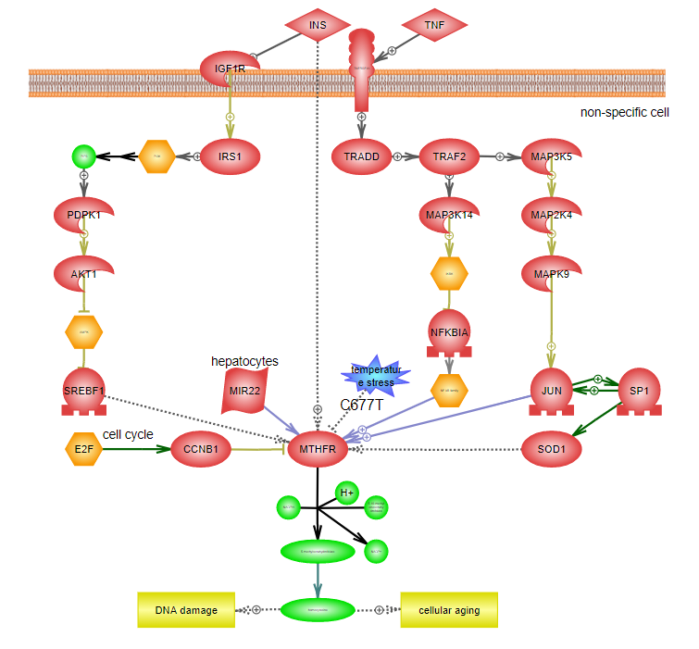
Resnet is a network transformed from text-mining analysis
Pathway Studio Pathways Collection includes ~3000 models, pathways
See more information in 2683_PS_QuickStartGuide_2020 and
DOI: 10.1016/C2018-0-00586-1

Slide 4
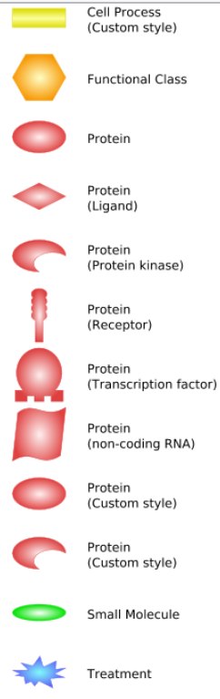
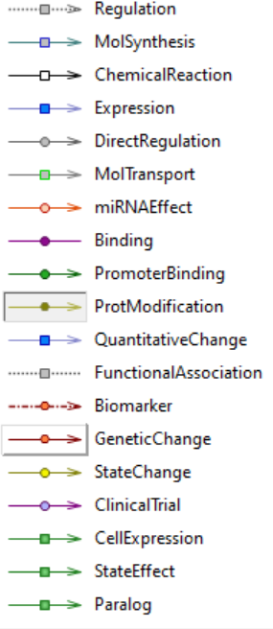
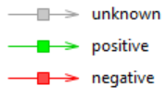
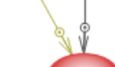

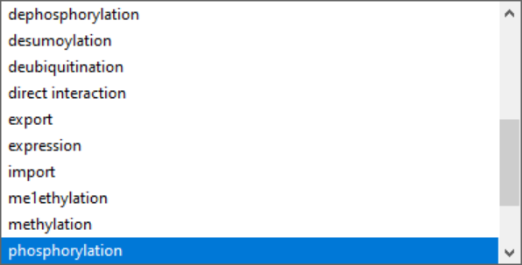
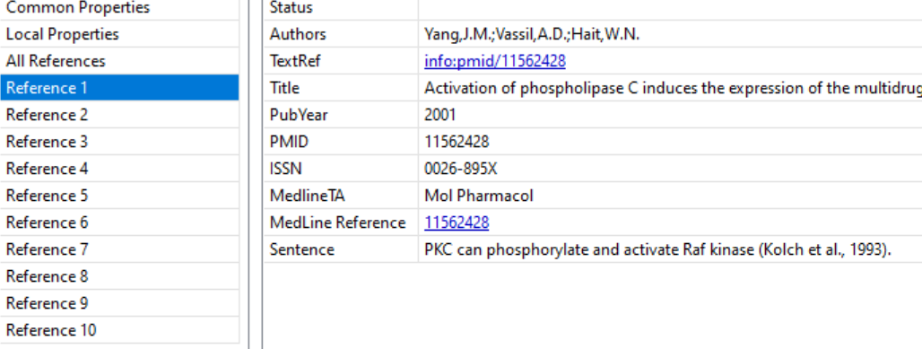
Protein-protein direct (physical)relations
positive
negative

Slide 5
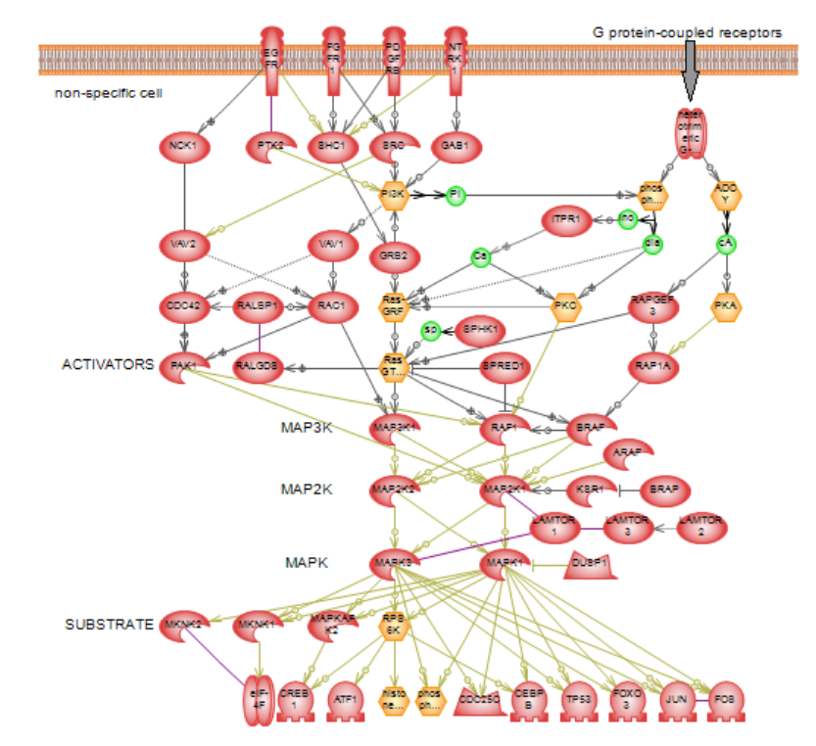
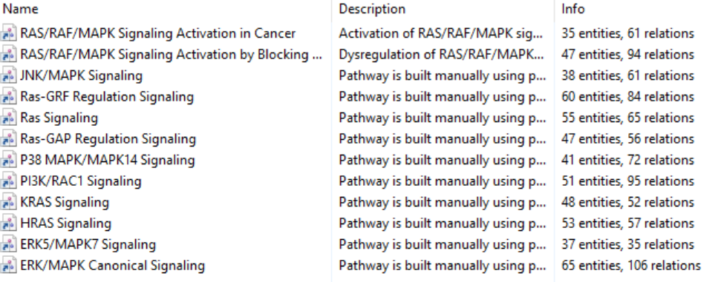
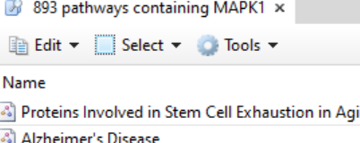


“RASs → RAFs → MAPK2/3 (MEK) → MAPK1/3 (ERK)”
In Pathway Studio Collection (2019)

Slide 6
To do:
models of RASs → RAFs → MAPK2/3 (MEK) → MAPK1/3 (ERK) cascade with scaffold proteins
export and share annotations of proteins from the cascade
export and share references (links to publications and extracted sentences supported the connection between entities in the network with links to publications)

Slide 7
Steps:
Search for proteins from the list of proteins in the database. Classify proteins by their role in the RASs->MEK1/2->ERK1/2 cascade (direct and indirect relations; only with effect, only high confidence, etc.)
Expand the list of RASs proteins selected by connections with MEK1/2 and ERK1/2
Expand the scaffold proteins (regulators) in public list selected by connections with ERK1/2 and MEK1/2 or RAFs AND RAS.
MAPK1/3 direct protein modificators (>2 references);
MAPK1/3 direct binding protein partners
MAPK1/3 direct promoter regulators (out of scope for this project)
MAPK1/3 molecular transport and miRNAs regulators (>2 references)
Make one pathway for each RASs member including related proteins from the public and direct regulators from network.
Make pathways for scaffold proteins
Add cell, cell processes and disease specificity
Add protein modification sites (experimental)
Make pathway taxonomy (experimental)
Add more complexes (optional)
Prepare files for sharing.

Slide 8
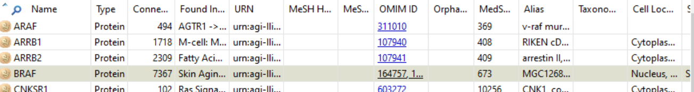
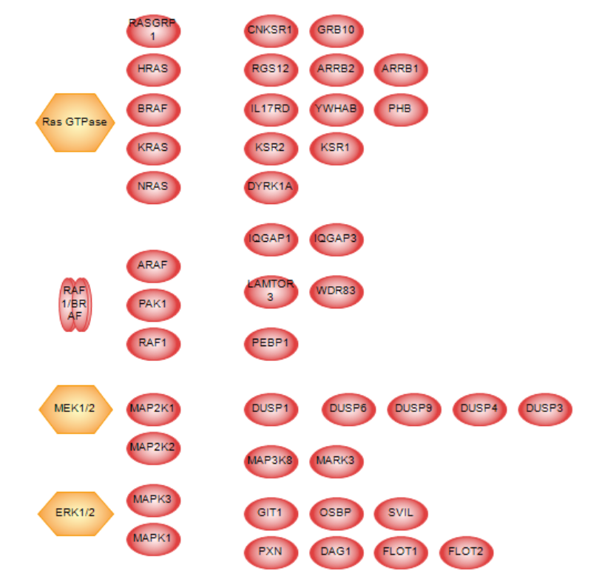
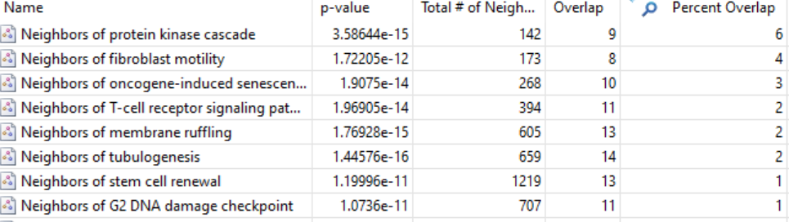
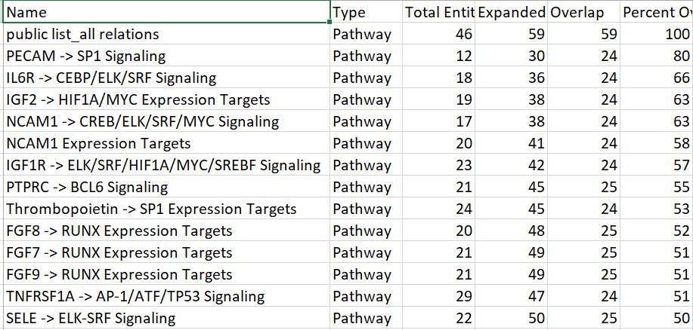
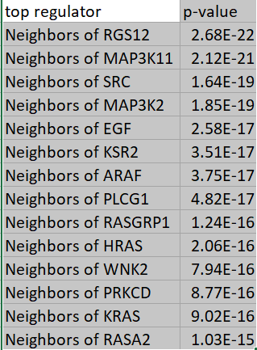
Search for proteins from the list of proteins in the database. Classify proteins by their role in the RASs->MEK1/2->ERK1/2 cascade (direct and indirect relations; only with effect, only high confidence, etc.)
Enrichment analysis:

Slide 9
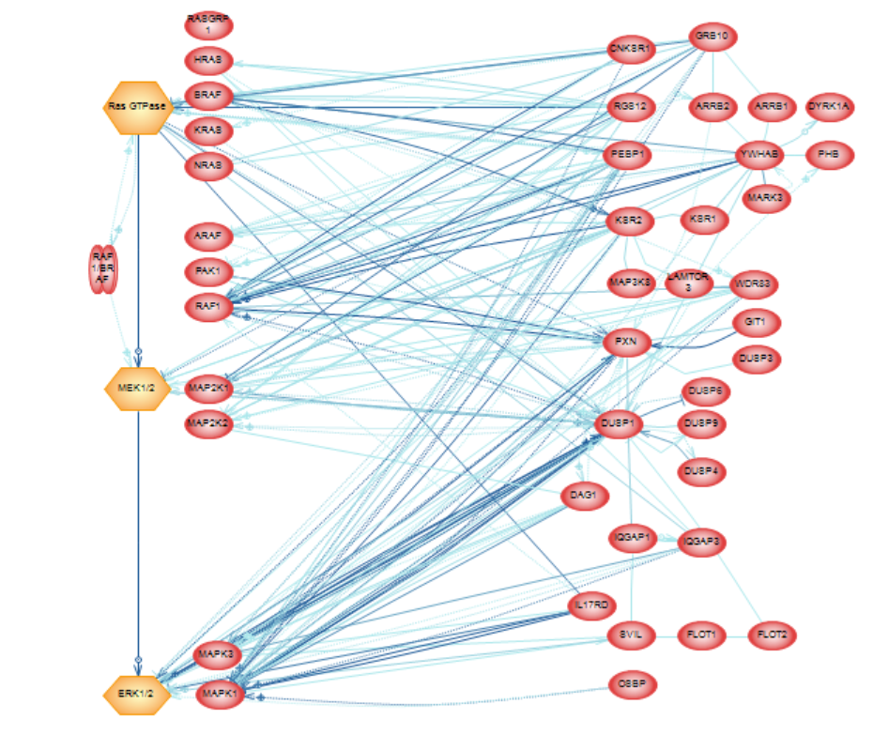
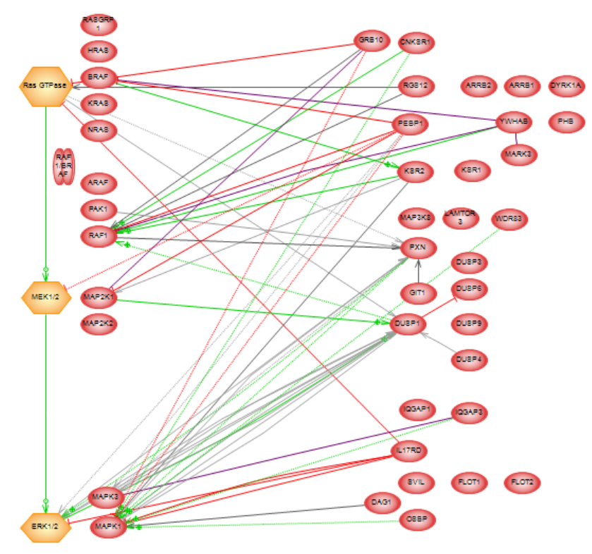
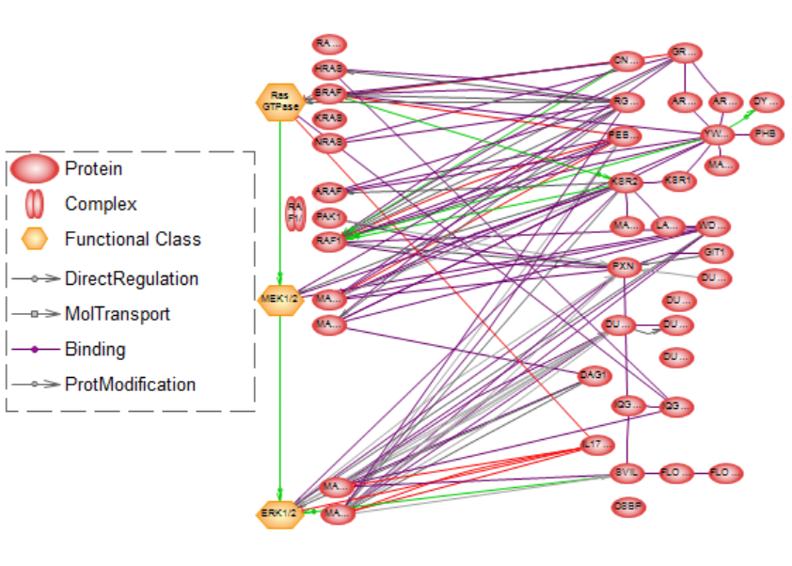
all relations in database
only direct relations
only high confidence relations (>5 references)

Slide 10
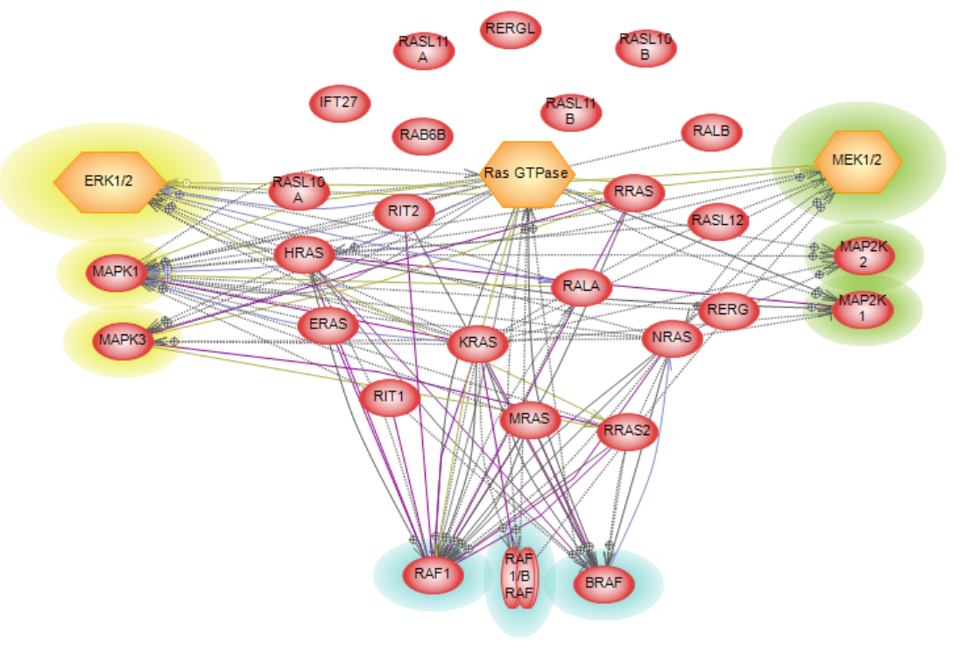
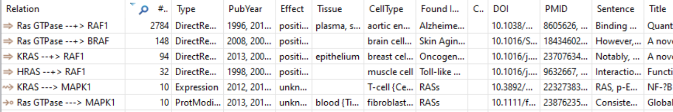
2. Expand the list of RASs proteins selected by connections with MEK1/2 and ERK1/2

Slide 11
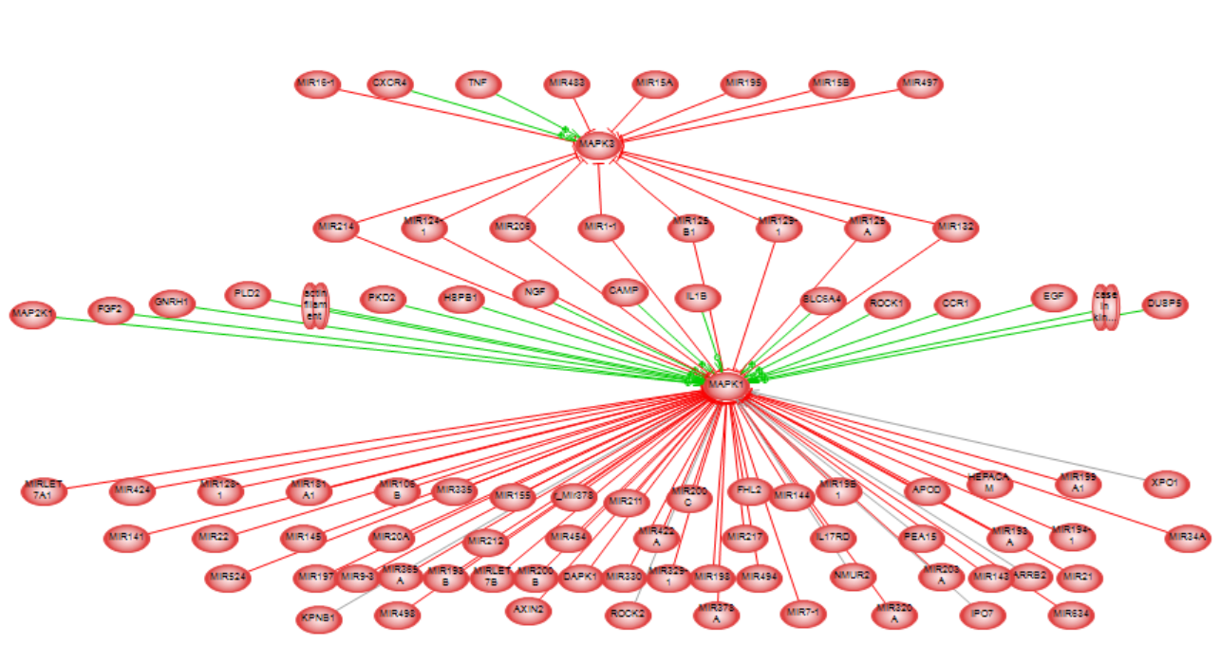
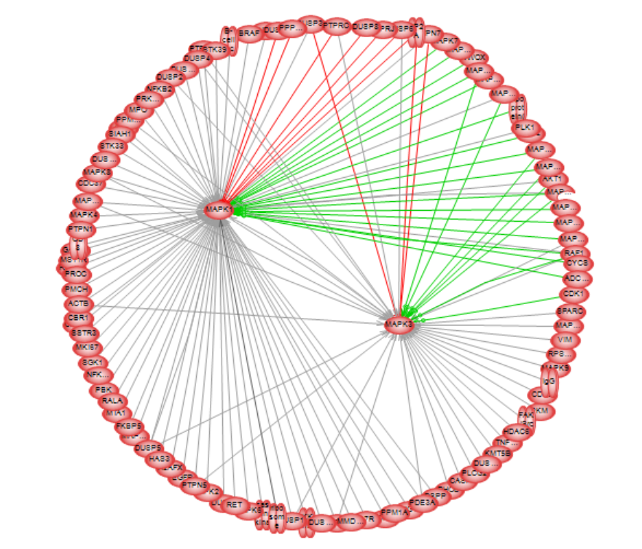
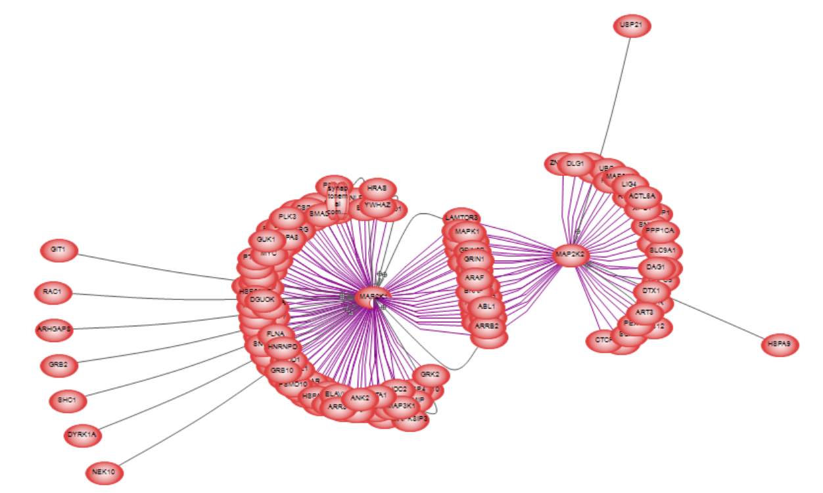
3. Expand the list of scaffold proteins (regulators) from the public list selected by connections with MAPK1/3 AND MEK1/2 or RAFs AND RAS.
MAPK1/3 direct protein modificators (>2 references);
MAPK1/3 direct binding protein partners
MAPK1/3 direct promoter regulators (out of scope for this project)
MAPK1/3 molecular transport and miRNAs regulators (>2 references)

Slide 12
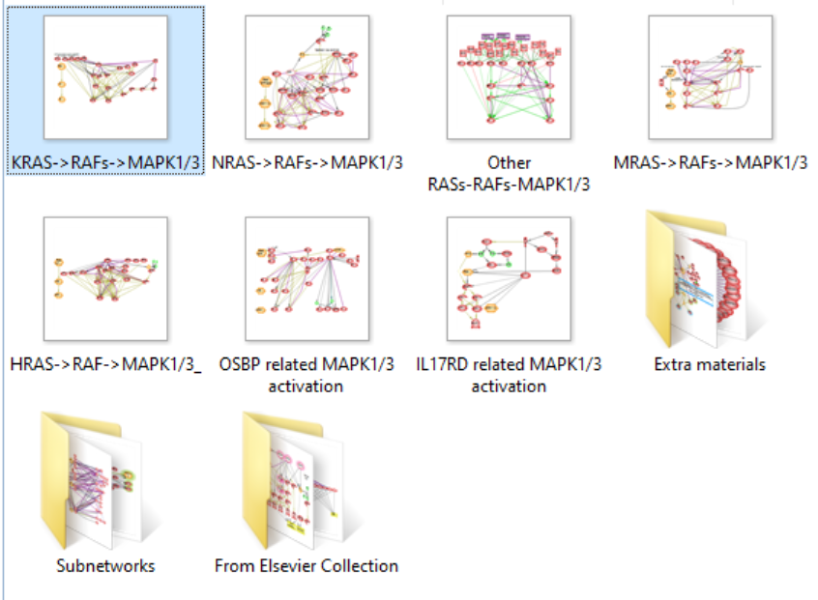
4. Make one pathway for each RASs member including related proteins from the public list and direct regulators from network.
5. Make pathways for scaffold proteins

Slide 13
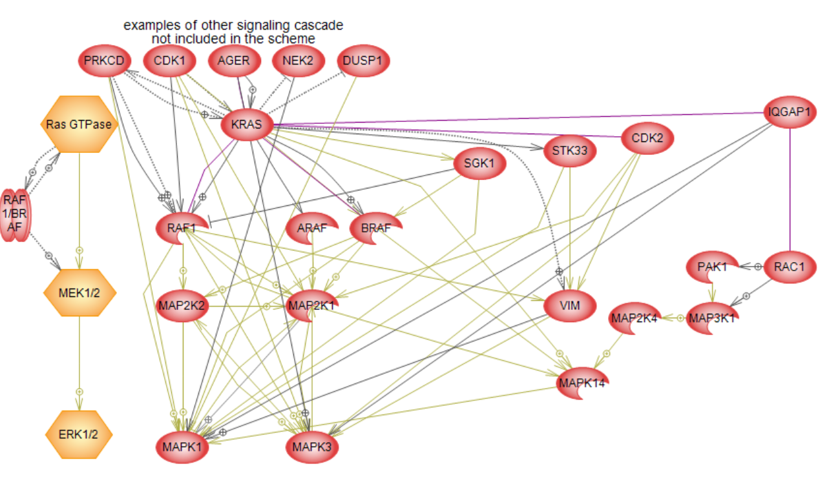
Logic of (semi)automatic reconstruction of a pathway templates.
Add direct linear cascade RAS -> RAFs -> MEK1/2 -> MAPK1/3
Add shortest path RAS -> MAPK1/3, and RAFs -> MAPK1/3
Add scaffold proteins in RAS -> MEK1/2 direct network neighbors and RAS -> MAPK1/3 direct network neighbors. (Neighbors = proteins and complexes that physically binds, or directly modify proteins.)
Read all references, delete false connections.
Mark connections with any specific context
Add new connections that come from reading references
Make layout.
8
3
2
1
2
9
What I did not include (only some examples):
8. proteins that (directly) involved in RAFs -> MEK1/2 -> MAPK1/3 but not stimulated by RAS (directly);
9. feedback loops
10. all specific links between triggers of RAS -> ->MAPK1/3 activation and their outputs

Slide 14
That is why these models are an Overviews of possibilities.
To create a distinct biochemical, kinetic protein modification pathway (SBGN – like) more context should be added for each protein-protein interaction.
For example, KRAS for sure can activate RAF1, ARAF or BRAF, but depending on which/how exactly sites in KRAS are altered RAF1, ARAF or BRAF will be activated differently.
Also, it is important to follow activation steps up to the final event in the model - MAPK1/3 activation.
For simplicity, one may say that if RAF1 is activated, all downstream cascades are also activated.
However, this may be not true due to presence of “scaffold” proteins, different sites modifications, homo/dimerization changes, etc.

Slide 15
That is why these models are an Overviews of possibilities.
Finally, what are “scaffold” (“direct regulators”) proteins?
Should they not only directly regulate the cascade but simultaneously be directly regulated by RAS?
How many “steps” should be between regulator and any protein in the cascade?
For example, I did not include transcriptional factors and all non initial RAS-directly activated regulators.

Slide 16
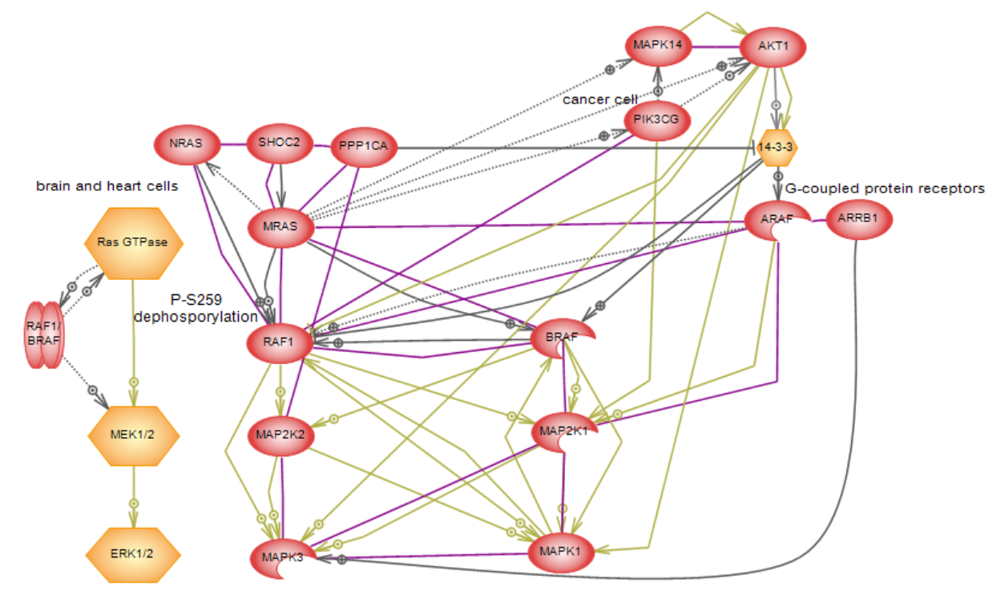
Example of challenges on MRAS cascade
Notes:
Raf proteins have two high-affinity phosphorylation-dependent 14-3-3- binding sites, with seemingly opposing functions; whereas binding to P-S621 is essential for activity, binding to P-S259 inhibits activity. …We report the identification of a complex comprised of Shoc2/Sur-8 and the catalytic subunit of protein phosphatase 1 (PP1c) as a highly specific effector of M-Ras. Shoc2 Can Stimulate Raf-ERK Activation by Ras PMID: 16630891
We observed that R-Ras3 is a relatively weak activator of the mitogen-activated protein kinase/extracellular-signal-regulated kinases (MAPK/ERKs) when compared to the H-Ras oncogene. On the contrary, both R-Ras3 and H-Ras activated the Jun N-terminal kinase (JNK) to a similar extent. R-Ras3 is not expressed in a ubiquitous fashion as its transcripts are restricted to the brain and the heart (Kimmelman et al., 1997; Matsumoto et al., 1997). R-Ras3 activation of Akt is PI3-K-dependent. PMID: 10803462
RPM/RGL3 inhibits activation of the Elk-1 transcription factor mediated by p21 Ras- and MEKK1-, but not Raf-1 M-Ras G22V-mediated activation of the Elk-1 dependent reporter gene was partially inhibited by RPM/RGL3 and completely inhibited by membrane localized RPM/RGL3. RPM/RGL3 does not affect the phosphorylation state of MAP-kinases Erk, JNK and p38
PMID: 11313946

Slide 17
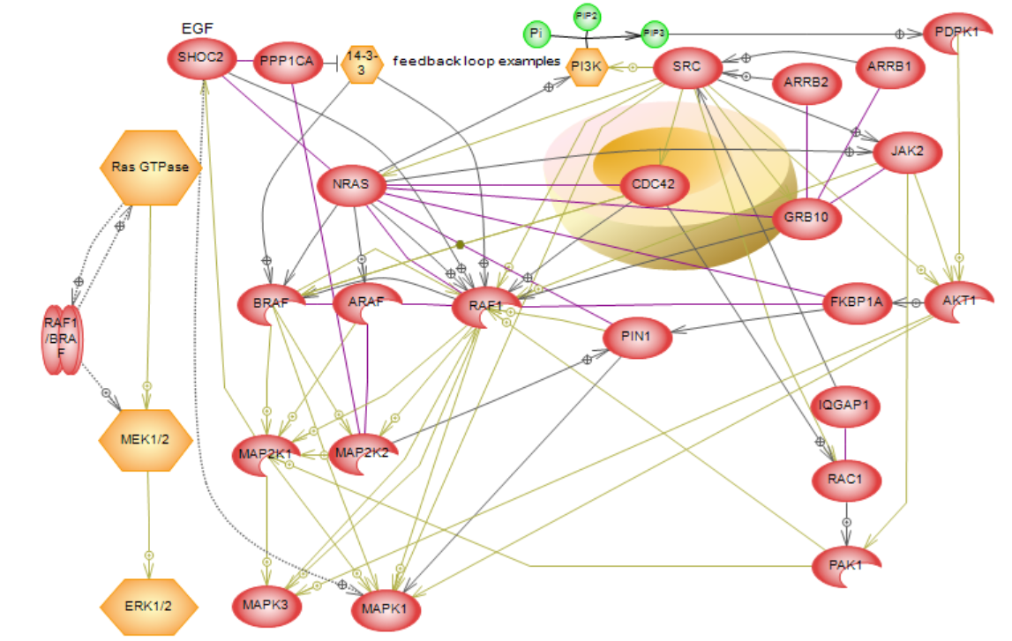
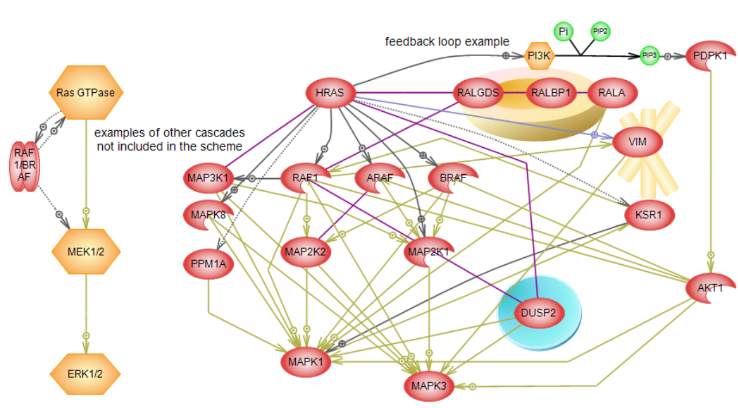

Slide 18
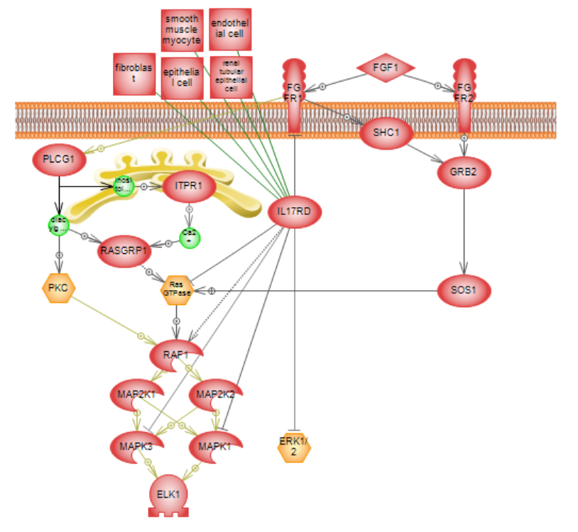
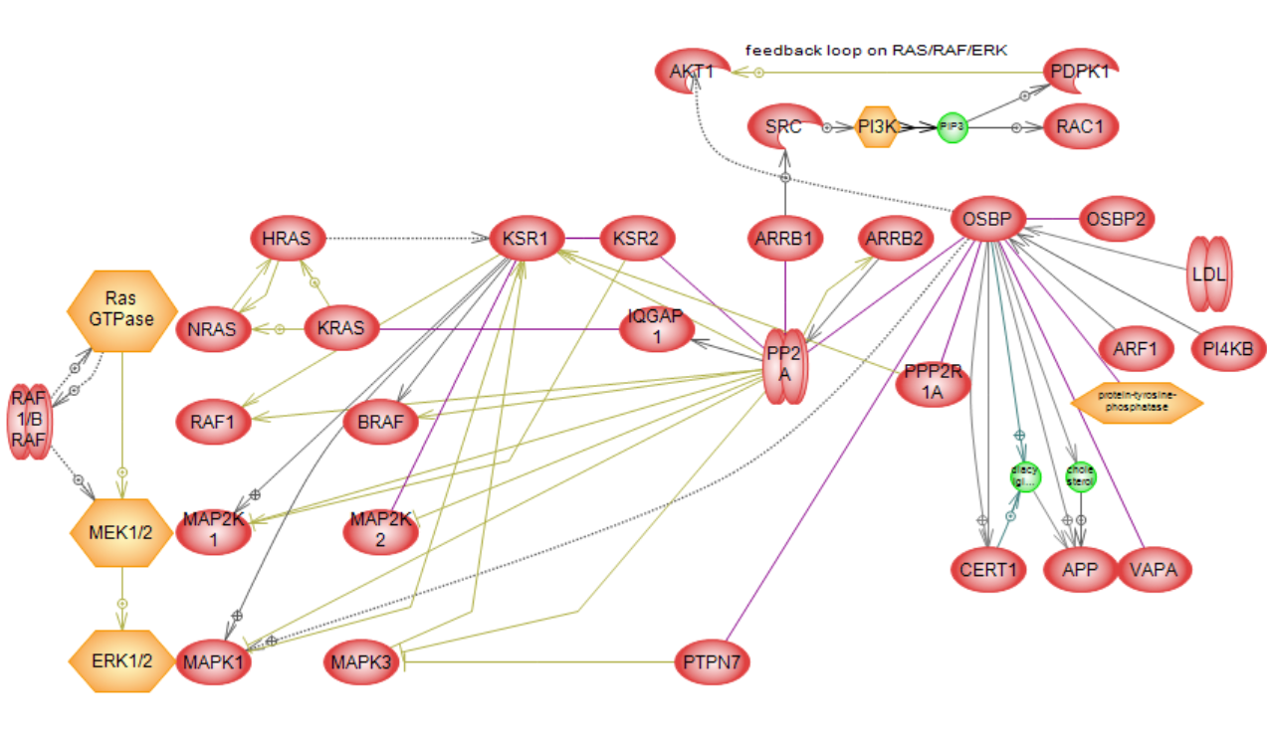
5. Make pathways for scaffold proteins from public list
Instead of making RAS/RAF/ERK a central axis, a regulator protein can be in the center of the model. This way, we can get around the question of what/how many “scaffold proteins” are “canonical” for RAS/RAF/ERK cascade. And add more specificity to the project.

Slide 19
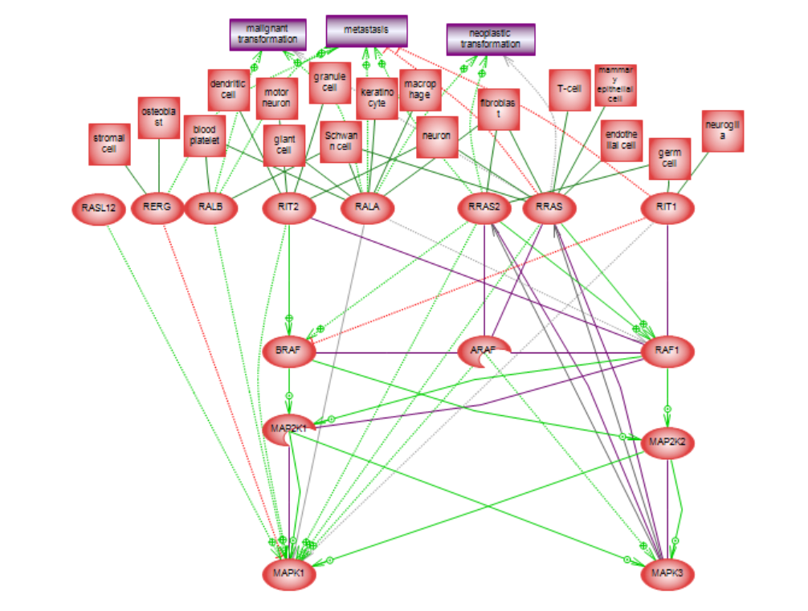
6. Add cell, cell processes and disease specificity
7. Add protein modification sites (experimental)
The specificity of RAS/RAF/ERK depends (mostly) on
→mutations in core proteins
→status of regulators (their specific expression, mutations, etc.)
→status of downstream effectors of ERK - direct and expression targets (their mutations, expression, presence of other regulators)
How to add specificity in general overviews?
→showing status of starting proteins – one of RAS, cell expression, their isoforms, mutations.
→adding specific regulators of core proteins (specific to a disease pathway or cell)

Slide 20
8. Make pathway taxonomy (experimental) ?
Taxonomy of models can be considered as “layers” or rules for the idea of the integrated complex map.
Taxonomy is a hierarchy of models and can be based on any principle.
Receptor signaling
Anatomy concept
Cell process around group of scaffold proteins.
Amino acid sites in RASs
Gene Ontology functional protein roles classification.
For this project one suggestion is go down by cascade:
KRAS
KRAS phSer181
KRAS-RAF1
KRAS-RAF1-MAP2K1
KRAS-RAF1-MA2K1-MAPK1
KRAS G12C Mutation
…
Each model will include all known scaffold proteins for specific protein interactions

Slide 21
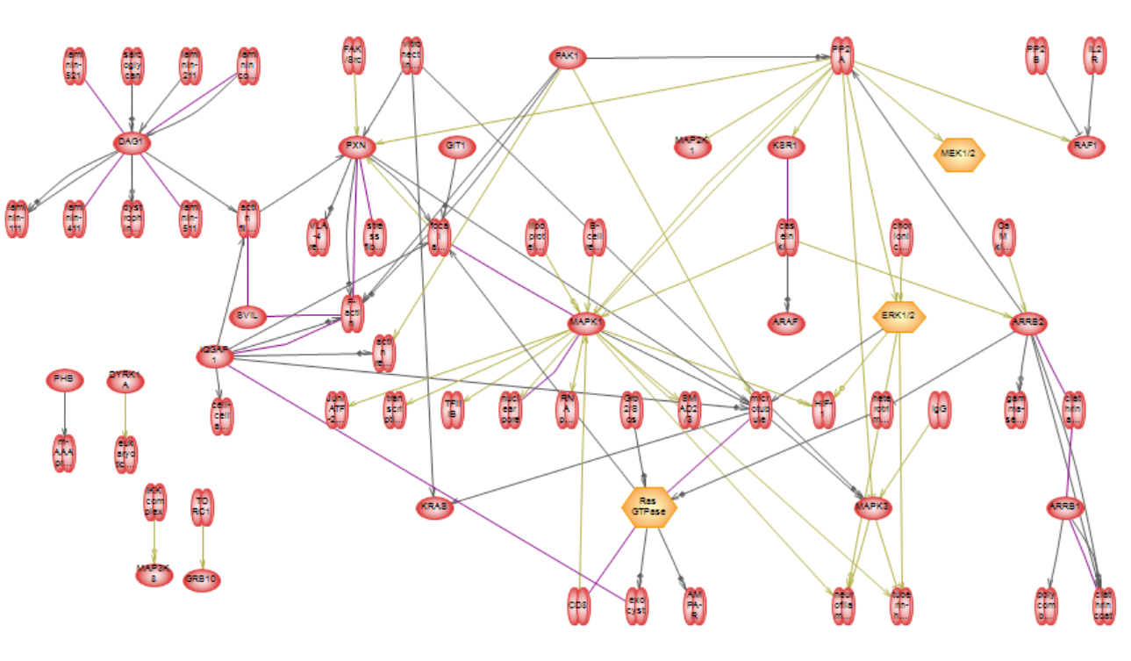
9. Add more complexes (optional).
Complexes with direct links with proteins from the public list (only with more than 5 references)

Slide 22
Files for sharing
Links to Pathway Studio for provided pathways (for reading protein annotation and selected references)
Tables with proteins annotations (by pathway)
Tables with relations annotations and selected references (by pathway)
SBGN converted (no annotations, only layout https://github.com/golovatenkop/rnef2sbgn, http://web.newteditor.org/)
Other ways to share data:
For each of pathway/sub network:
Images/html (include protein annotations, please use EXPLORER to open)
RNEF files (original PS format)
Tables with proteins/relationships annotations (by entity/protein/cell/etc. For example, all data for ERK)
Other ways to share? (networks-format, Cystoscope)
Only selected annotations and references were exported in tables (to make file sizes manageable). It is possible to export more by request.
Resnet-2020 was used. It is possible to update files with Resnet-2021.
7 pathways for the project (for 6/23/2021)
12 Pathways from Collection
9 Subnetworks

